Slide 1
BIKE TAXI METER
BY
ARHAM HUSSAIN
VARALA VINITH REDDY
SRUJAN KUMAR ALLENKI

Slide 2
INTRODUCTION
In present era transportation is compulsory, people hardly believe in fare charges so we came up with bike taximeter which enhances trust in the customers regarding fare calculation when you rent a bike to them.

Slide 3
COMPONENTS USED
Arduino Uno Board
Arduino IDE
GSM Module
Display
Hall sensor
Connecting wires

Slide 4
1.ARDUINO UNO
The arduino UNO is a microcontroller board based on Atmega328.
It has 14 digital input/output pins,6 analog pins, a 16MHz resonator, USB connection, power jack, reset button.
These pins are used as a key for extending the computing capability of arduino UNO into the real world

Slide 5
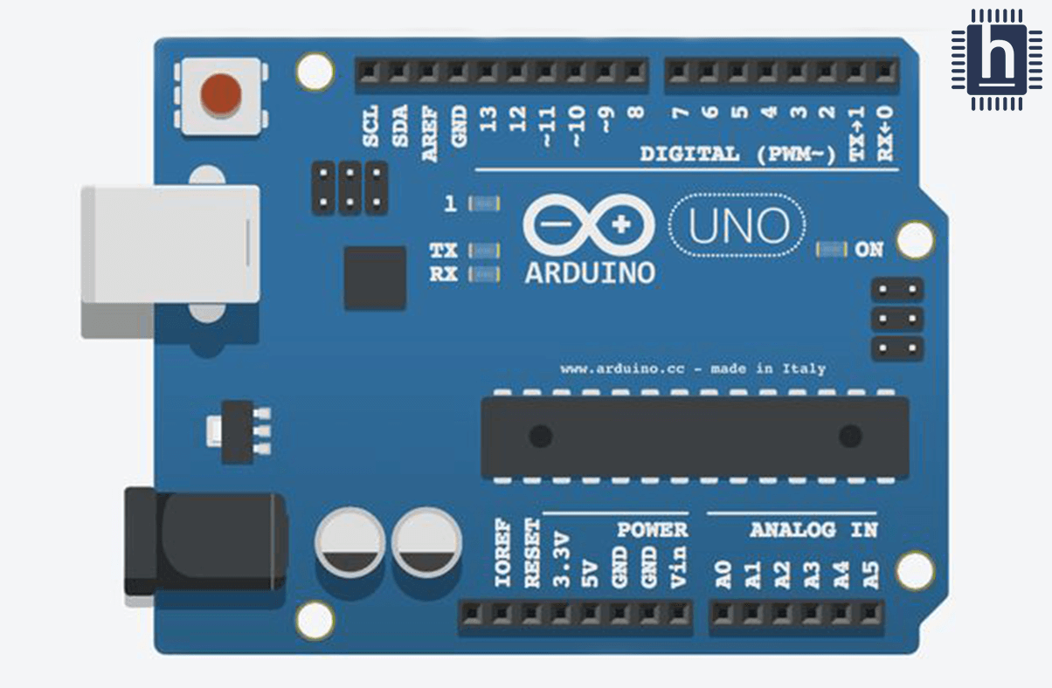

Slide 6

2.ARDUINO IDE
The arduino Integrated Development Environment(IDE) is a cross-platform application for Windows, MacOS, Linux. It is used to write and upload programs to Arduino board.

Slide 7
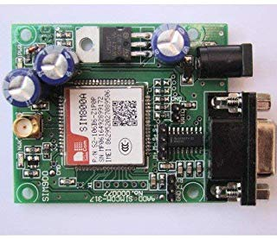
3.GSM Module
GSM Module is a chip or circuit that will be used to establish communication between a mobile device or a computing machine and GSM system.

Slide 8
Function of GSM module
Read, write and delete SMS messages.
Send SMS messages.
Monitor the signal strength.
Monitor the charging status and charge level of the battery.
Read, write and search phone book entries.

Slide 9
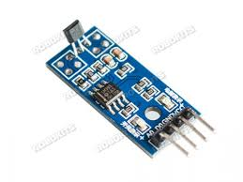
4.HALL SENSOR
A device used to measure the magnitude of a magnetic field. Its output voltage is directly proportional to the magnetic field strength through it.

Slide 10
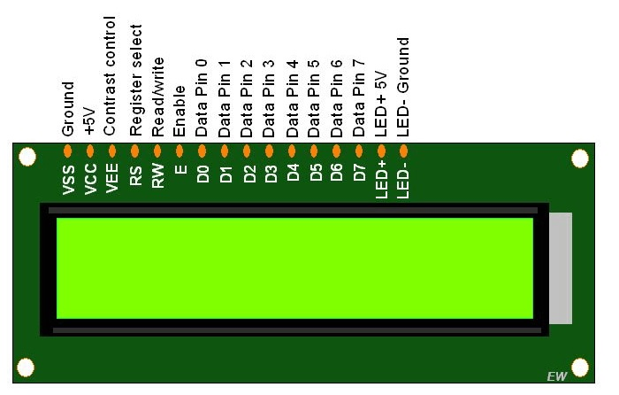
LIQUID CRYSTAL DISPLAY
Liquid Crystal is a special kind of substance which has properties intermediary between the properties of the solid and liquids.

Slide 11
WORKING
The distance travelled is calculated by using
Hall sensor and a magnet. A magnet is
attached to the front tyre ( known diameter)
When the vehicle moves Hall sensor detects the
magnet per each rotation i.e. it counts the
number of rotations(n). Multiplying n with
known diameter gives the total distance
travelled. We use a GSM module through which
we can send the final fare as an SMS and display
the fare on the display screen.

Slide 12
APPLICATIONS
It can be used as a bike taximeter.
Its features can be improved by adding GPS.

